Slide 1

Europe’s Premier HPC Event
ISC’09
June 23-26, 2009
Hamburg
www.supercomp.de

Slide 2
EUROPE‘S PREMIER HPC EVENT
Development of Participants and Projection (*)
Mannheim
Heidelberg
Dresden
Hamburg

Slide 3
EUROPE‘S PREMIER HPC EVENT
Development of Exhibition Floor Space in sqm and Projection (*)
Heidelberg
Dresden
Hamburg

Slide 4
EUROPE‘S PREMIER HPC EVENT
ISC’09 Conference Program Highlights
ISC’09 Keynote Talk by Andreas von Bechtolsheim, legendary Co-Founder, Chief Architect and Senior Vice President, Systems Group, Sun Microsystems, USA: The Evolution of Interconnects for High-Performance Computing
Prof. Dr. Gunter Dueck, IBM Distinguished Engineer & Member of the IBM Academy of Technology: Lean Brain Management – More Success and Efficiency by Saving Intelligence.
Conference Sessions on HPC & Weather/Climate, HPC & Aerospace, Multicore Programming
Notes:
I will give you the answer on this slide:
- At ISC there are all important European HPC key players. There is no other place in the world where you can meet them on one spot.
- Then, ISC has grown to an ideal size with participant numbers of around 1000, which ensures productive sessions and interactions in a familiar atmosphere.
- Our conference program is exceptional. We try every year to excell last year’s program. (And since we celebrate our twenty-second anniversary this year, you might estimate the quality of this year’s program. ) The particular feature of our program is, that the speakers of the main track, which is a single track, are hand-selected. Only the best minds of the HPC community will present at ISC. This to guarantee the best quality of the presentations.
- ISC’s Exhibition with appr. 100 exhibitors from industry and research is the perfect place for meeting the key players of the European supercomputing market.
- Another reason to attend are our legendary after hour social events, where all attendees get to know each other, keep in touch and do business in a great and familiar atmosphere.
- Last but not least: the location itself, Dresden is one of the most beautiful cities in the world
Before I continue with my talk, I will show you some photographs to give you an impression of the particular atmosphere of our event

Slide 5
EUROPE‘S PREMIER HPC EVENT
Main Focus at ISC’09: Cloud Computing
IBM, HP, Microsoft
Google, Amazon, Yahoo
Specialized sessions on Multicore/Manycore Architechtures, HPC & Seismic, Gas & Oil Applications, GPU and Extreme Data Management Mining
Thomas Sterling puts the past HPC year in perspective
Notes:
I will give you the answer on this slide:
- At ISC there are all important European HPC key players. There is no other place in the world where you can meet them on one spot.
- Then, ISC has grown to an ideal size with participant numbers of around 1000, which ensures productive sessions and interactions in a familiar atmosphere.
- Our conference program is exceptional. We try every year to excell last year’s program. (And since we celebrate our twenty-second anniversary this year, you might estimate the quality of this year’s program. ) The particular feature of our program is, that the speakers of the main track, which is a single track, are hand-selected. Only the best minds of the HPC community will present at ISC. This to guarantee the best quality of the presentations.
- ISC’s Exhibition with appr. 100 exhibitors from industry and research is the perfect place for meeting the key players of the European supercomputing market.
- Another reason to attend are our legendary after hour social events, where all attendees get to know each other, keep in touch and do business in a great and familiar atmosphere.
- Last but not least: the location itself, Dresden is one of the most beautiful cities in the world
Before I continue with my talk, I will show you some photographs to give you an impression of the particular atmosphere of our event

Slide 6
EUROPE‘S PREMIER HPC EVENT
ISC’09 Conference Program Highlights
Hot Seat Session: Grilling the leading HPC vendors with tough questions
Exhibitor Forum Sessions featuring briefings on the newest technologies
Scientific Session, including the ISC and PRACE award winning papers
Research Poster Session highlighting late-breaking research
Notes:
I will give you the answer on this slide:
- At ISC there are all important European HPC key players. There is no other place in the world where you can meet them on one spot.
- Then, ISC has grown to an ideal size with participant numbers of around 1000, which ensures productive sessions and interactions in a familiar atmosphere.
- Our conference program is exceptional. We try every year to excell last year’s program. (And since we celebrate our twenty-second anniversary this year, you might estimate the quality of this year’s program. ) The particular feature of our program is, that the speakers of the main track, which is a single track, are hand-selected. Only the best minds of the HPC community will present at ISC. This to guarantee the best quality of the presentations.
- ISC’s Exhibition with appr. 100 exhibitors from industry and research is the perfect place for meeting the key players of the European supercomputing market.
- Another reason to attend are our legendary after hour social events, where all attendees get to know each other, keep in touch and do business in a great and familiar atmosphere.
- Last but not least: the location itself, Dresden is one of the most beautiful cities in the world
Before I continue with my talk, I will show you some photographs to give you an impression of the particular atmosphere of our event

Slide 7
EUROPE‘S PREMIER HPC EVENT
ISC’09 Conference Program Highlights
HPC & WEATHER/CLIMATE MODELING
HPC & AEROSPACE
HPC & CLOUD COMPUTING – SYNERGY OR COMPETITION?
HPC & SEISMIC/GAS & OIL
GPU PANEL
EXTREME DATA MANAGEMENT/MINING
MULTICORE / MANYCORE
EXHIBITION
EXIBITOR FORUM SESSION 1 - 6
SCIENTIFIC SESSION 1 - 3
BoF SESSIONS 1 – 6
RESEARCH POSTER SESSION
HOT SEAT SESSION 1 – 2
Notes:
I will give you the answer on this slide:
- At ISC there are all important European HPC key players. There is no other place in the world where you can meet them on one spot.
- Then, ISC has grown to an ideal size with participant numbers of around 1000, which ensures productive sessions and interactions in a familiar atmosphere.
- Our conference program is exceptional. We try every year to excell last year’s program. (And since we celebrate our twenty-second anniversary this year, you might estimate the quality of this year’s program. ) The particular feature of our program is, that the speakers of the main track, which is a single track, are hand-selected. Only the best minds of the HPC community will present at ISC. This to guarantee the best quality of the presentations.
- ISC’s Exhibition with appr. 100 exhibitors from industry and research is the perfect place for meeting the key players of the European supercomputing market.
- Another reason to attend are our legendary after hour social events, where all attendees get to know each other, keep in touch and do business in a great and familiar atmosphere.
- Last but not least: the location itself, Dresden is one of the most beautiful cities in the world
Before I continue with my talk, I will show you some photographs to give you an impression of the particular atmosphere of our event

Slide 8

EUROPE‘S PREMIER HPC EVENT
Release of the 33rd TOP500 List at ISC’09
Ranking the World’s
500 Fastest Supercomputers by
Performance

Slide 9
EUROPE‘S PREMIER HPC EVENT
Pricing Structure
 | Conference (Tue-Thu) | Conference Fri | Conference Tue-Fri | Exhibition Pass * (Wed-Thu) | Exhibition Pass * Tue | Booth Pass **
Industrie | 300,00 € | 150,00 € | 900,00 € | 100,00 € | 50,00 € | 250,00 €
Academia | 200,00 € | 100,00 € | 600,00 € | 100,00 € | 50,00 € | 250,00 €
Students | 80,00 € | 40,00 € | 240,00 € | / | / | /
* Exhibition, Exhibitor Forum
** Exhibition, Exhbitor Forum, Hot-Seat, BoFs

Slide 10
EUROPE‘S PREMIER HPC EVENT
ISC’09 Platinum Sponsors
Notes:
10
I

Slide 11
EUROPE‘S PREMIER HPC EVENT
ISC’09 Gold Sponsors
ISC’09 Silver Sponsors
Notes:
11
I

Slide 12
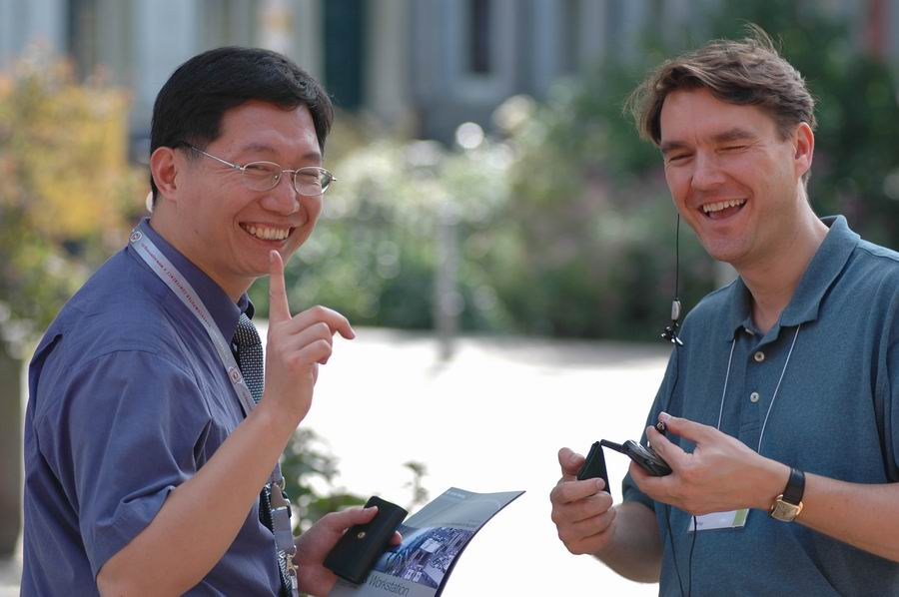
See You in Hamburg!
Notes:
Ok, this is the end of my talk, thank you very much for your attention and I hope to see many of you in Hamburg next Summer!

